Slide 1
Preluare si compilare din diverse surse
Alexandrescu Andrei - Modern C++ Design: Generic Programming and Design Patterns Applied
https://www.geeksforgeeks.org/smart-pointers-cpp/
https://www.geeksforgeeks.org/auto_ptr-unique_ptr-shared_ptr-weak_ptr-2/
https://beginnersbook.com/2017/08/cpp-functions/
https://www.softwaretestinghelp.com/lambdas-in-cpp/
https://riptutorial.com/cplusplus/example/1854/what-is-a-lambda-expression-
https://en.cppreference.com/w/cpp/language/lambda
https://docs.microsoft.com/en-us/cpp/cpp/lambda-expressions-in-cpp?view=msvc-170

Slide 2
Smart pointers
Problem: no delete
class TEST { … };
void fun(){ TEST * p = new TEST(); }
int main()
{ // Infinite Loop
while (1) {
fun();
}
}
p will be destroyed as it is a local variable. But, the memory it consumed won’t be deallocated because we forgot to use delete p;

Slide 3
Smart pointers
Problem: no delete
not deallocating a pointer causes a memory leak that may lead to crash of the program
C++11 comes up with its own mechanism to smartly deallocate unused memory: Smart Pointer. When the object is destroyed it frees the memory as well.
The idea is to take a class with a pointer, destructor and overloaded operators like * and ->. Since the destructor is automatically called when an object goes out of scope, the dynamically allocated memory would automatically be deleted (or reference count can be decremented).

Slide 4
Smart pointers
C++ objects that simulate simple pointers by implementing operator-> and the unary operator*.
perform useful tasks—such as memory management or locking.
almost all good-quality smart pointers in existence are templated by the pointee type.
replace pointer definitions with smart pointer definitions without incurring major changes to your application’s code
Smart pointers have value semantics, whereas some simple pointers do not; An object with value semantics is an object that you can copy and assign to.

Slide 5
Smart pointers
class SmartPtr {
public:
explicit SmartPtr (int* ptr = NULL) : { p = ptr; }
~SmartPtr() { delete p; }
int& operator*() const { return *p; }
private:
int* p;
};
int main() {
SmartPtr ptr(new int());
*ptr = 20;
cout << *ptr;
}
// We don't need to call delete ptr: when the object
// ptr goes out of scope, the destructor for it is automatically
// called and destructor does delete ptr.

Slide 6
Smart pointers
template<class T>
class SmartPtr {
public:
explicit SmartPtr (T* ptr = NULL) : { p = ptr; }
~SmartPtr() { delete p; }
T& operator*() const { return *p; }
T* operator->() const {return p;}
private:
T* p;
};
int main() {
SmartPtr<int> ptr(new int());
*ptr = 20;
cout << *ptr; }

Slide 7
Smart pointers
Types of smart pointers
auto_ptr (is deprecated)
1. unique_ptr
unique_ptr stores one pointer only. We can assign a different object by removing the current object from the pointer.
2. shared_ptr
By using shared_ptr more than one pointer can point to this one object at a time and it’ll maintain a Reference Counter using use_count() method.
3. weak_ptr
It’s much more similar to shared_ptr except it’ll not maintain a Reference Counter. In this case, a pointer will not have a stronghold on the object.

Slide 8
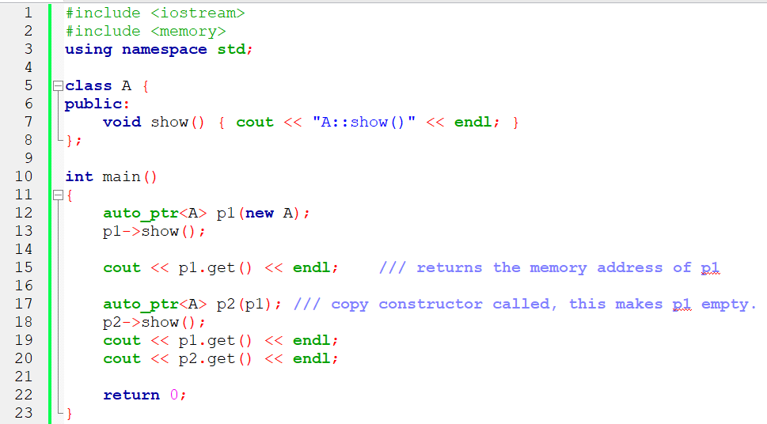
Smart pointers
auto_ptr

Slide 9
Smart pointers
unique_ptr
std::unique_ptr was developed in C++11 as a replacement for std::auto_ptr.
unique_ptr is a new facility with similar functionality, but with improved security (no fake copy assignments), added features (deleters) and support for arrays.
any attempt to make a copy of unique_ptr will cause a compile-time error.
unique_ptr<A> ptr1 (new A);
// Error: can't copy unique_ptr
unique_ptr<A> ptr2 = ptr1;
unique_ptr can be moved using the new move semantics i.e. using std::move() function to transfer ownership of the contained pointer to another unique_ptr.

Slide 10
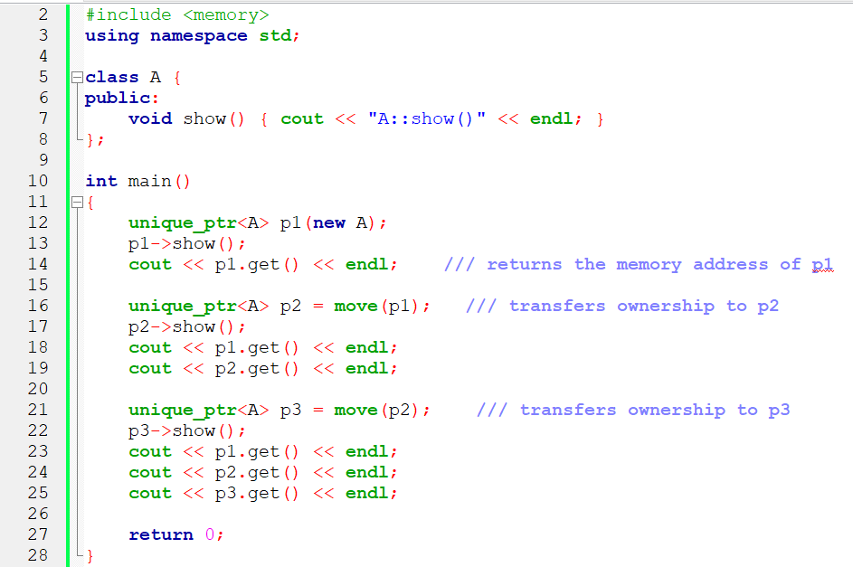
Smart pointers
unique_ptr

Slide 11
Smart pointers
shared_ptr
A shared_ptr is a container for raw pointers. It is a reference counting ownership model i.e. it maintains the reference count of its contained pointer in cooperation with all copies of the shared_ptr. So, the counter is incremented each time a new pointer points to the resource and decremented when the destructor of the object is called.
An object referenced by the contained raw pointer will not be destroyed until reference count is greater than zero i.e. until all copies of shared_ptr have been deleted.

Slide 12
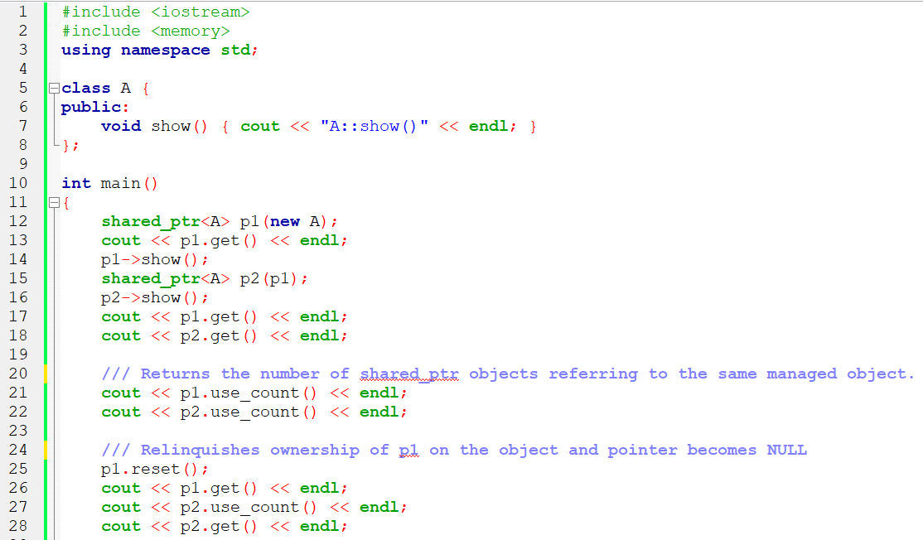
Smart pointers
shared_ptr

Slide 13
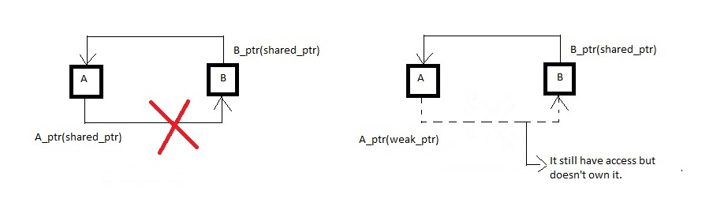
Smart pointers
weak_ptr
A weak_ptr is created as a copy of shared_ptr. It provides access to an object that is owned by one or more shared_ptr instances but does not participate in reference counting. The existence or destruction of weak_ptr has no effect on the shared_ptr or its other copies. It is required in some cases to break circular references between shared_ptr instances.

Slide 14
Move Constructors in C++
Copy constructors in C++ work with the l-value references and copy semantics(copy semantics means copying the actual data of the object to another object rather than making another object to point the already existing object in the heap).
Move constructors work on the r-value references and move semantics(move semantics involves pointing to the already existing object in the memory).
Work of move constructor looks a bit like default member-wise copy constructor but in this case, it nulls out the pointer of the temporary object preventing more than one object to point to same memory location.

Slide 15
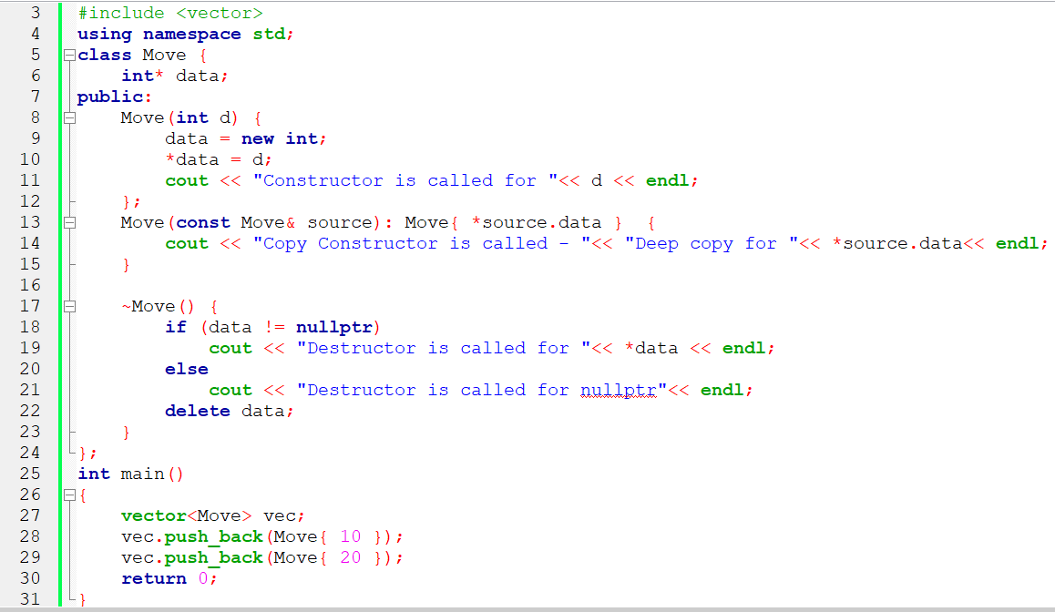
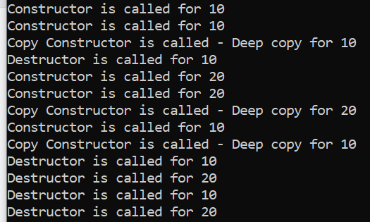
Move Constructors in C++

Slide 16
Move Constructors in C++
Syntax of the Move Constructor:
Object_name(Object_name&& obj)
: data{ obj.data }
{
// Nulling out the pointer to the temporary data
obj.data = nullptr;
}
This unnecessary use of the memory can be avoided by using move constructor.

Slide 17
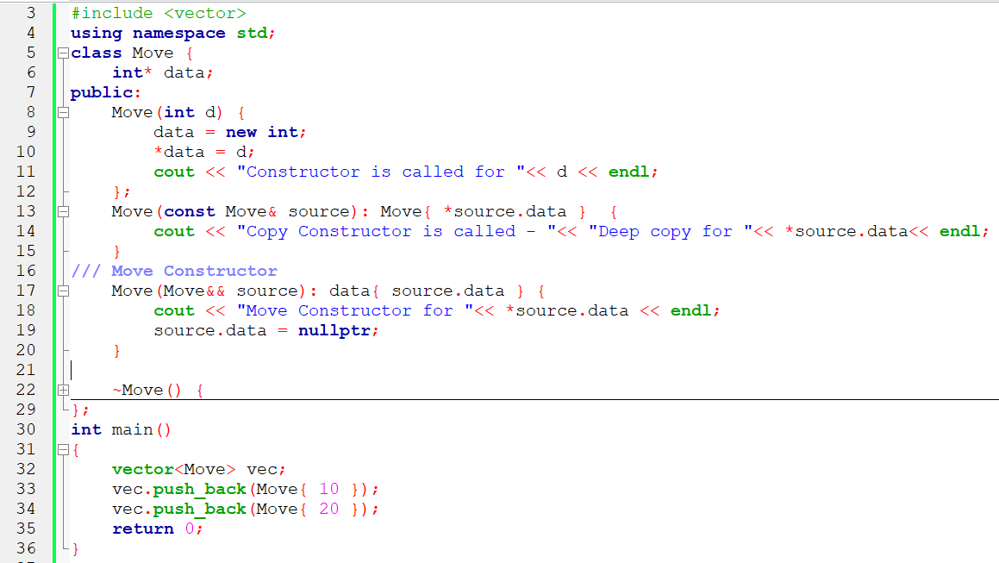
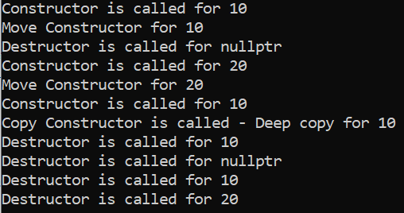
Move Constructors in C++

Slide 18
Lambda expressions
Lambdas, as they are commonly called, are basically small inline snippets of code that can be used inside functions or even function call statements. They are not named or reused.
General syntax
[Capture clause] (parameter_list) mutable exception ->return_type
{
Method definition;
}

Slide 19
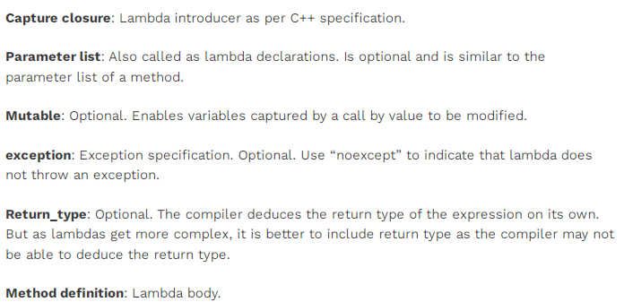
Lambda expressions

Slide 20
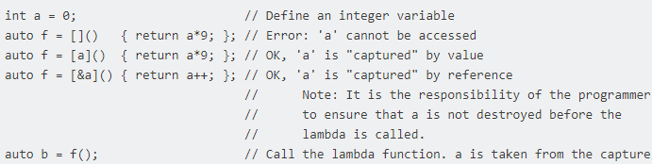
Lambda expressions
Capture clause
A lambda can introduce new variables in its body (in C++14), and it can also access, or capture, variables from the surrounding scope.
Variables that have the ampersand (&) prefix are accessed by reference and variables that don't have it are accessed by value.
An empty capture clause, [ ], indicates that the body of the lambda expression accesses no variables in the enclosing scope.

Slide 21
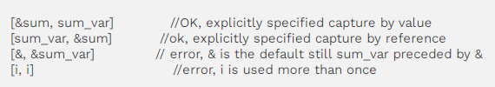
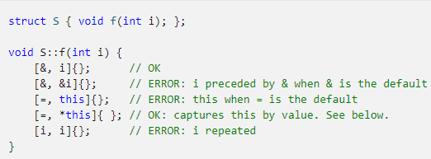
Lambda expressions
If we have a capture-default & a capture clause, then we cannot have an identifier in the capture of that particular capture can have the & identifier. Similarly, if the capture clause contains capture-default =, then the capture clause cannot have the form = identifier.

Slide 22
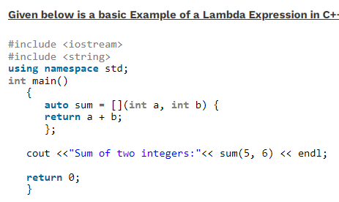
Lambda expressions

Slide 23
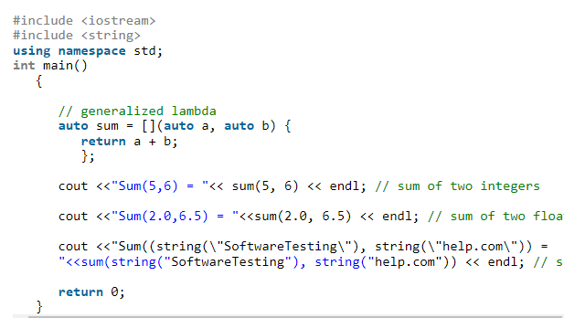
Lambda expressions
lambdas generalized for all data types. This is done from C++14 onwards.

Slide 24
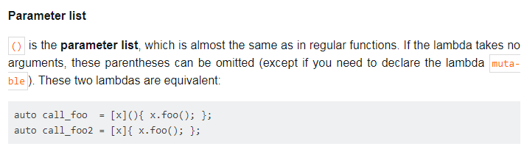
Lambda expressions
C++14
auto sort_cpp11 = [](std::vector<T>::const_reference lhs, std::vector<T>::const_reference rhs) { return lhs < rhs; };
auto sort_cpp14 = [](const auto &lhs, const auto &rhs) { return lhs < rhs; };

Slide 25
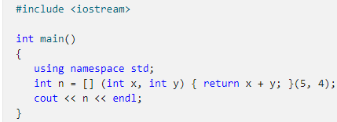
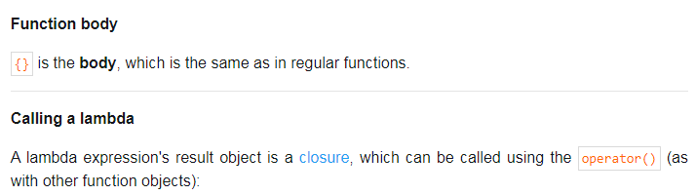
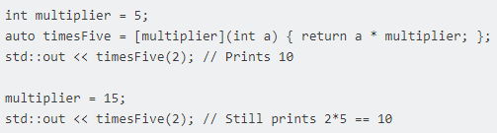
Lambda expressions

Slide 26
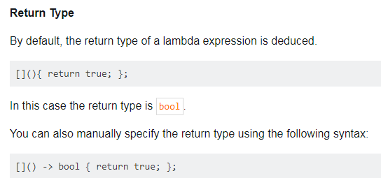
Lambda expressions

Slide 27
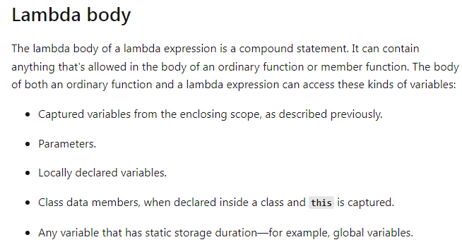
Lambda expressions

Slide 28
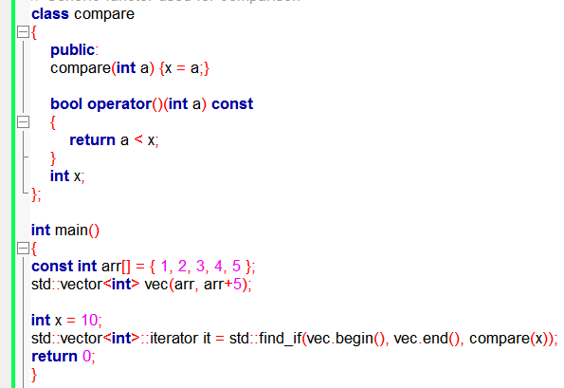

Lambda expressions
Before C++11
After C++11

Slide 29
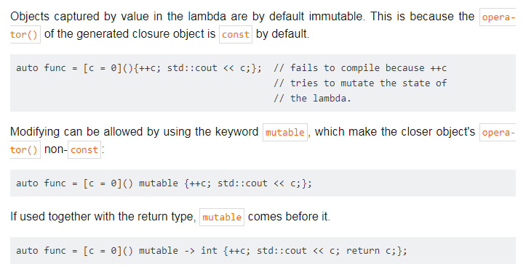
Mutable Lambda

Slide 30
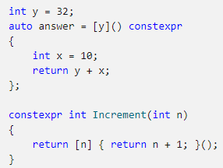
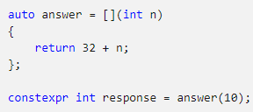
constexpr lambda expressions
(available in /std:c++17 mode and later): You may declare a lambda expression as constexpr (or use it in a constant expression) when the initialization of each captured or introduced data member is allowed within a constant expression.

Slide 31
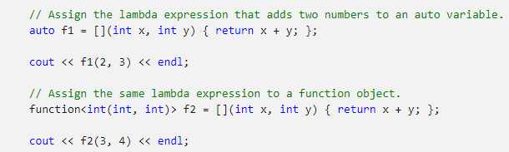
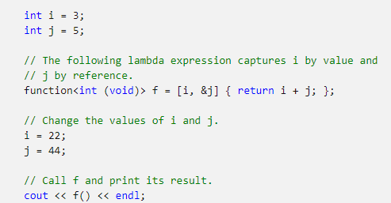
Lambda expressions
Examples

Slide 32

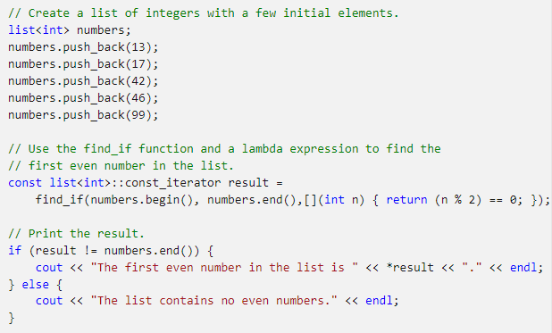
Lambda expressions
Examples

Slide 33
Lambda expressions
Examples
// The following lambda expression contains a nested
// lambda expression.
int timestwoplusthree = [](int x) { return [](int y) { return y * 2; }(x) + 3; }(5);
// Print the result.
cout << timestwoplusthree << endl;
}

Slide 34
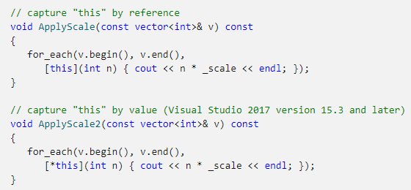
Lambda expressions
Examples

Slide 35
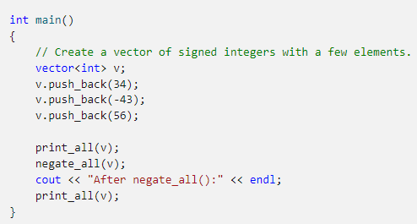
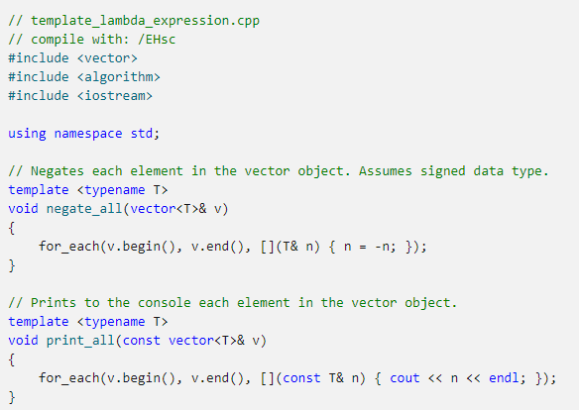
Lambda expressions
Examples

Slide 36
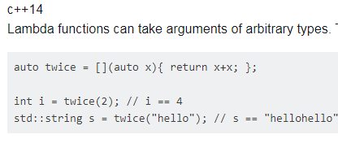
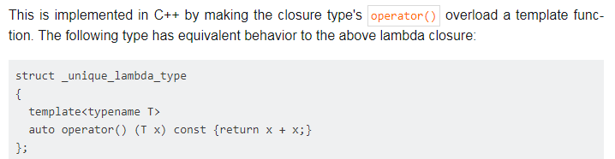
Generic Lambda
https://riptutorial.com/cplusplus/example/1969/generic-lambdas

Slide 37
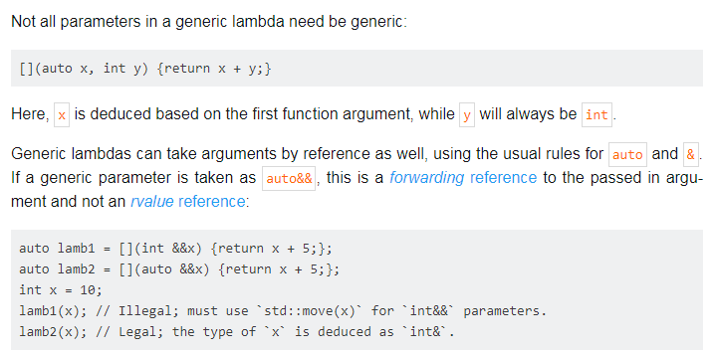
Generic Lambda
https://riptutorial.com/cplusplus/example/1969/generic-lambdas

Slide 38
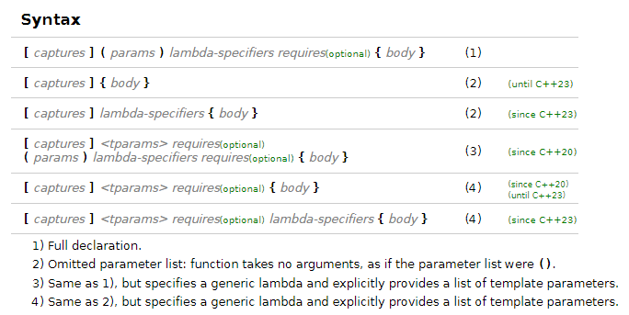
Lambda expressions
Future
https://en.cppreference.com/w/cpp/language/lambda

Slide 39
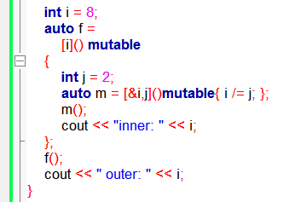
Lambda expressions
To do:
int i=1, j=2, k=3;
auto f = [i,&j,&k]() mutable {
auto m = [&i,j,&k]() mutable
{
i=4;
j=5;
k=6;
};
m();
cout << i << j << k;
};
f();
cout << " : " << i << j << k;

